Slide 1


Data Analysis

Slide 2


Today's agenda
Project recap
Problem
The Analytics team
Process
Insights
Summary

Slide 3

Social Buzz is fast growing technology in which we have analysed the data on the basis of the data collected.
Main three key points on which we worked are as follows-
1. Category Popular
2. Time in which content is liked most
3. Top most scoring categories
These insights will be beneficial for the company.
Project Recap

Slide 4

Problem
The problem statement is to find the top 5 categories in the Social Buzz Company.
This is the topic of the concern for us on which we mainly worked.

Slide 5



Aditi Satsangi
Data Analyst
The Analytics team
Marcus Rompton
Senior Principle
Andrew Fleming
Cheif Technical Architect

Slide 6
Process
1
Load Data.
2
Explore Data.
Group by Category.
3
Aggregate Metrics:
4
Sort and Get Top 5:
5
6
Visualize the results

Slide 7
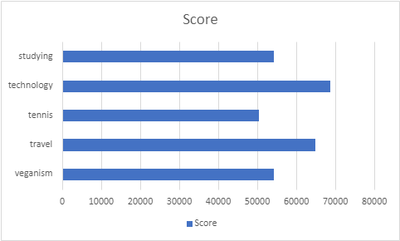
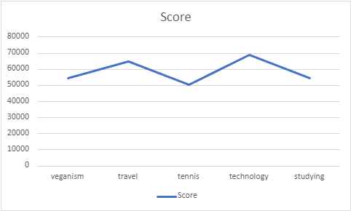

Insights
TOP 5 CATEGORIES
This shows the top 5 categories after data modelling.

Slide 8
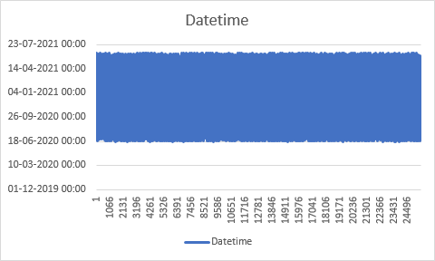
DATE TIME ANALYSIS
TOP CATEGORIES
Category | Score
veganism | 54269
travel | 64880
tennis | 50339
technology | 68738
studying | 54269

Slide 9
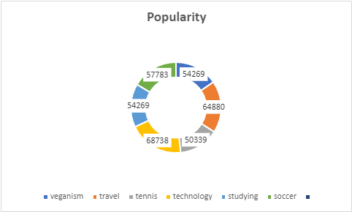
POPULARITY BASED ANALYSIS

Slide 10


In summary we can say that we have represented the insights by the graph. Now we come to the conclusion thta the technology categoery is the most populated one.
Summary

Slide 11
Thank you!
ANY QUESTIONS?

